Slide 1
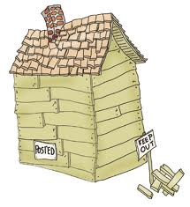
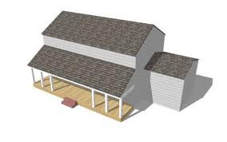
A House
Without doors, windows!!!
Similarly, a software without any interfaces is of no use!!
Utility connections!!

Slide 2
Interfaces
Between Components
E.g. A gas pipe from kitchen to living room
E.g. A class calling method of another class
Between Self and External Entities
E.g. Gas connection from SNGPL/SSGPL, water connection from WASA
E.g. Our software interacting with bank, NADRA
Between Self and Human
E.g. Door bell, button to switch on a tube light/fan
E.g. A User clicking on print button, login button, post button on screen

Slide 3
Interfaces
Between Components (Software Components)
E.g. A gas pipe from kitchen to living room
E.g. E.g. A class calling method of another class
Between Self and External Entities (Software and nonhuman producer/consumer of info)
E.g. Gas connection from SNGPL/SSGPL, water connection from WASA, sewerage
E.g. Our software interacting with bank, NADRA
Between Self and Human (Software and Human, User Interface)
E.g. Door bell, button to switch on a tube light/fan
E.g. A User clicking on print button, login button, post button on screen
A User Interface can be:
Command Line
Graphical

Slide 4
GUIs
Reduced many interfacing problems
Found to be difficult to learn, hard to use, confusing in some cases?
Any experiences?
UIs should be easy to:
Learn
Use
Understand

Slide 5
Designing User Interface
An effective communication medium between a human and a computer
Creation of a screen layout
Study of people and how they relate to technology by answering questions like:
Who is the user?
How does the user learn to interact with the system?
How does the user interpret info produced by the system?
What will the user expect of the system?

Slide 6
Golden Rules
Place the User in Control
Reduce User’s Memory Load
Make the Interface Consistent

Slide 7
Place the user in control
System should react to user needs
System should help the user complete tasks
User should not feel that the system is controlling the user
e.g OS commands

Slide 8
Place the user in control
Design Principles:
Define interactions s.t. a user is not forced into unnecessary/undesired actions/modes
Provide flexible interaction
User should not feel that the system is controlling the user
Allow interruptible and undoable user interactions
Streamline interactions based on skill level, allow interactions to be customized
Hide technical internals from casual user
Provide mechanism for direct interaction with objects on screen

Slide 9
Reduce the user’s memory load
The more a user has to remember, the more error-prone the interaction
Design principles:
Reduce demand on short term memory
Establish meaningful defaults example reset
Define shortcuts that are intuitive: Alt:P
Disclose information in a progressive manner. Example
Select text and show text styles

Slide 10
Make the interface consistent
Maintain design rules for all screens
Design principles:
Allow user to put current task into a meaningful context: graphical icons
Maintain consistency across a complete product line: CNTRL+C
Avoid violating de facto standards

Slide 11
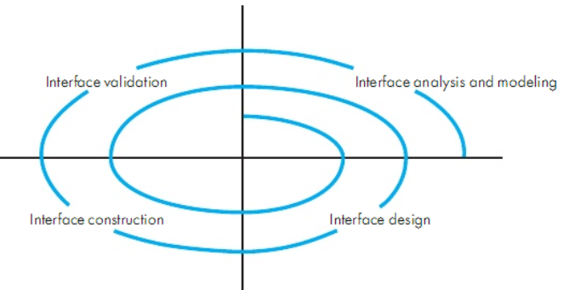
UID Process

Slide 12
UID Process
Interface Analysis
User Model
Profile of end user
Age, gender, education, physical abilities, cultural/ethnic background etc.
Novice, Knowledgeable, Knowledgeable frequent users
Design Model
Mental Model
User’s perception of the system
Implementation Model

Slide 13
UID Process
Interface Design
Define interface objects and actions
Interface Construction
Creation of prototypes to evaluate usage scenarios
Interface Validation
Ability to implement every user task correctly
Degree to which interface is easy to use
User’s acceptance to user interface as useful

Slide 14
Interface Analysis
User Analysis
Trained professionals? Technicians? Clerks? Etc.
Average level of formal education?
User capability to learn from written material/training?
Expert typists? Do no like keyboard?
Age range?
Users represented predominantly by one gender?
Routine of work? Regular? Overtime?
Frequency of usage?
Primary spoken language of users?
Subject matter experts?
Desire to know underlying technology

Slide 15
Interface Analysis
Task Analysis
Work performed by user in particular circumstances
Tasks/subtasks performed by the user during the work being performed
Problem domain objects manipulated by users
Sequence of work tasks? Flow of actions? The workflow?
Hierarchy of tasks
Techniques used to support task analysis
Usecases
Task Elaboration(Functional decomposition)
Object Elaboration(Classes and attributes)
Workflow Analysis

Slide 16
Interface Analysis
Analysis and display content
Partitioning of large objects (e.g. reports) for better understanding
Use of colors to improve understanding
Content of error messages?

Slide 17
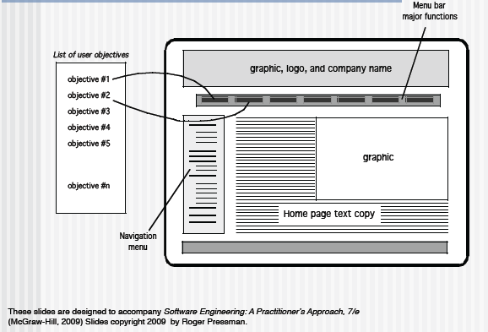
Mapping User Objectives

Slide 18
Design Issues
Response time
Help
Help without leaving the interface?
Error information handling

Slide 19
References
Pfleeger Book slides from UCF
Bruegge et al. OOSE book
Book and slides from Pressman
http://www.authorstream.com/Presentation/umr17-1645231-pressman-ch-12-user-interface-design/
Acknowledgement!
Some slides have been reused from UCF slides for the SE course, specially for UI design
Majorly, flow of UCF slides has been modified and a few examples have been added

